Slide 1
INVESTIGATING THE LAG STRUCTURE OF THE EDUCATION-INCOME INEQUALITY RELATIONSHIP
Author(s): Salvatore Babones, Kandi Felmet, Jackie Hwang
Presented By: Junyi Wang

Slide 2
Kuznets Conjecture
Levels of income inequality are driven by levels of development
Pre-industrial societies had very low income inequality
The levels of income inequality would decline in a fully-developed nation
Inverted U shape model

Slide 3
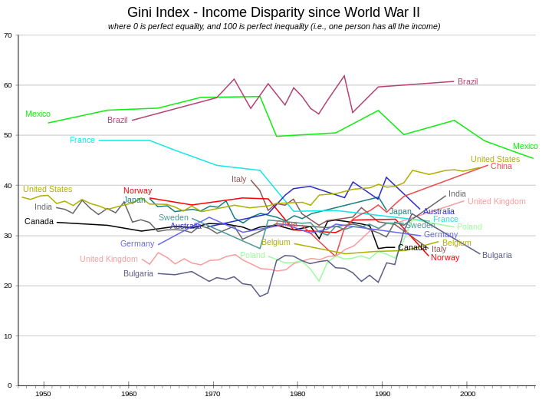
Contradictory Results

Slide 4
Wide variability exists both among developed countries and developing countries
Income inequality is unrelated to country size. All levels of income inequality can be found in countries ranging from a few million to billions of people

Slide 5
Existing Literature
Focused mainly on the contemporaneous relationship between education and income inequality
No theoretical reason
There might be a lag between the changes
Even possible that education is entirely endogenous to income inequality

Slide 6
Data & Results
Longitudinal data from 87 countries
Income is recorded using the Gini coefficient
Polynomial regression models have been used to fill in missing data points
Education data include average year of schooling and Gini coefficients of educational inequality
Five-year intervals

Slide 7
Figure 1. Cross-correlations between education operationalization and income

Slide 8
Average education is more strongly correlated with income inequality than is educational inequality
Education seems to be correlated with income inequality with no lags
Income inequality may better predict average education than the other way around (rule out the possibility of endogeneity)
No evidence of any lag in
education & income inequality

Slide 9
Further investigation
Correlate education in particular years with the full range of available income inequality data
Figure 2 charts the correlation of education in 1970 with income inequality over a range of years.
Figure 3 moves forward to chart the correlation of education in 1990 with income inequality over the same range of years

Slide 11
Education in 1970 VS Education in 1990
Very similar: the peak correlations occur with income inequality data in the mid 1980s
Two Explanations
The lag period between education and income inequality changed from - 15 years to +5 years between 1970 and 1990
Mid-1980s income inequality data are simply the data that are most strongly correlated with education

Slide 12
Further Analysis
Figure 4 charts the contemporaneous correlation between education and income inequality
For both the educational inequality and education level operationalization, the maximum correlation with income inequality is achieved in mid-1980s.

Slide 13
Education in 1970 (or 1990) is highly correlated with education in 1980, which is in turn correlated with income inequality in 1980.
The observed lag structures of the data are apparently generated by changes in the contemporaneous correlation over time, combined with high levels of autocorrelation in all of the variables.

Slide 14
Conclusion
Not a evidence of a contemporaneous impact of education on income inequality
Lagging education will not improve results or lead to different conclusions because countries' relative levels of both education and income inequality are so stable over time that lagging over periods of as long as 20 years (in either direction) has no effect.
The education - income inequality relationship tends to be stable across all time lags.
Suggestion: Elucidate the causal paths connecting education with income inequality focus on the patterns of individual countries' levels of income inequality over time.

